Slide 1
FrameAR
empowering creative forces

Slide 2
OUR VISION
making it easier to create and collaborate with the latest in tech

Slide 3
OUR TOOLS
stdlib & slack
rapid-development
painless integration
non-technical use
built for cross-functional teams

Slide 4
SOME INTERESTING NUMBERS
40 million
SKETCHUP, MAYA AND 3D SOFTWARE USERS
$56 billion
AR INDUSTRY NETWORTH BY 2020
10 million
DAILY SLACK USERS

Slide 5



WHAT IS FRAME-AR?
version
control
Slack
integration
AR
visualization

Slide 6
WHAT IS FRAME-AR?
version control
frame commit - frame branches - frame diff
frame tree – user commenting

Slide 7
WHAT IS FRAME-AR?
AR visualization
iOS AR app – view projects – compare versions
make annotations – all file support

Slide 8
WHAT IS FRAME-AR?
Slack integration
Slack bot – reports commits – team flow
direct app launch on commit

Slide 9




FRAME-AR APPLICATIONS
gaming
entertainment
architecture
marketing

Slide 10


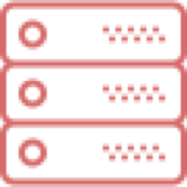




OUR TOOLS
kotlin
react
stdlib
swift
mongoDB

Slide 11
NEXT STEPS
share frame projects
issue reporting
version control insights
animated/interactive models
AR collaboration
and much, much more…

Slide 12
demo

